Slide 1
IOT BASED LETTERBOX
TASK 3 - Interface of Wi Fi, Ultrasonic sensors and Cloud service.
Group 10
Student – Surjeet Singh

Slide 2
CONTANTS
Interface of Wi-Fi adapter
Interface of Ultrasonic sensors
Setting up Thing Speak service
References

Slide 3
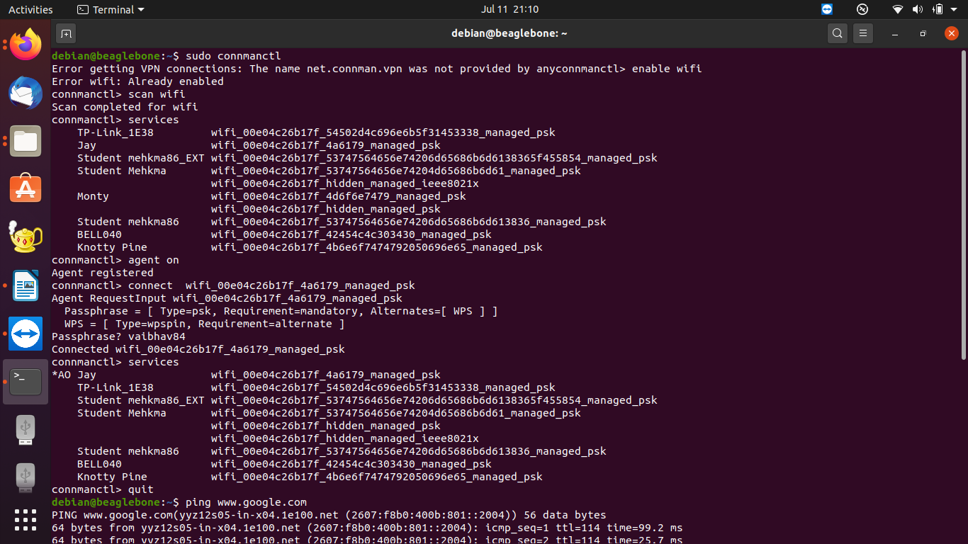
Interfacing Wi-Fi Adapter using USB port

Slide 4
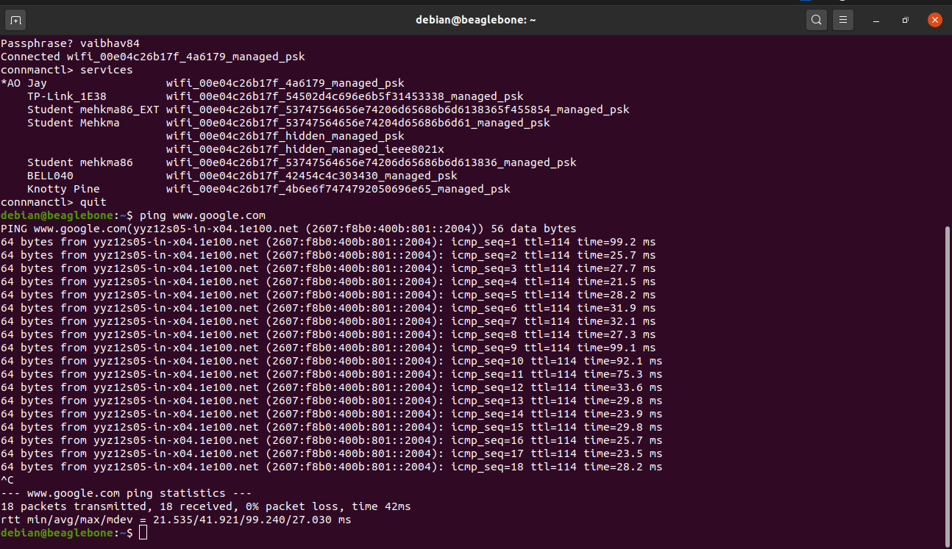
Ping of google webpage.

Slide 5
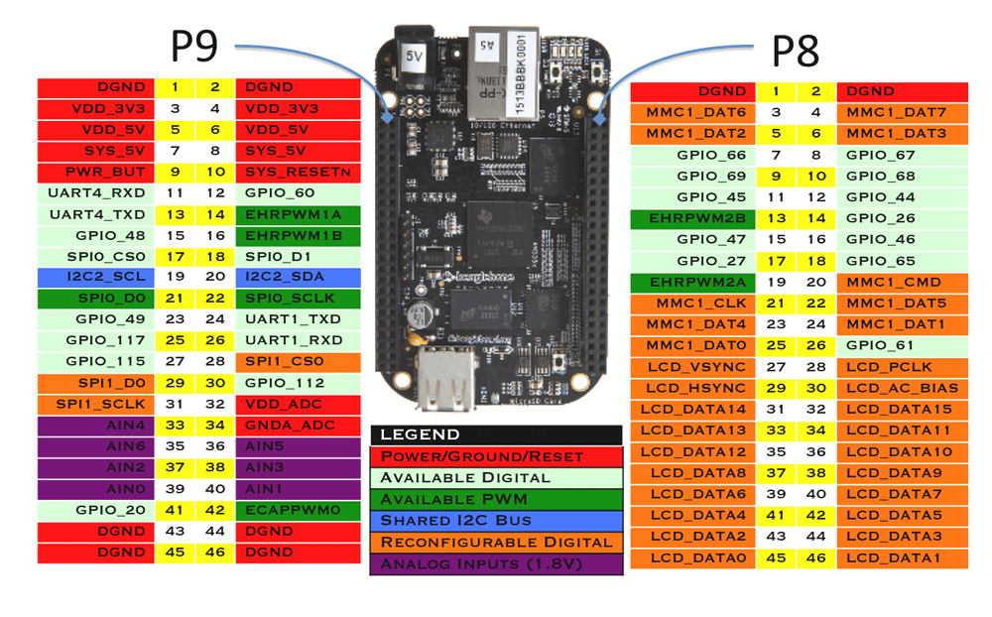
Pin Out of Beagle Bone Black
Ground
Power Supply
9,10,11,12 pins for Sensors

Slide 6
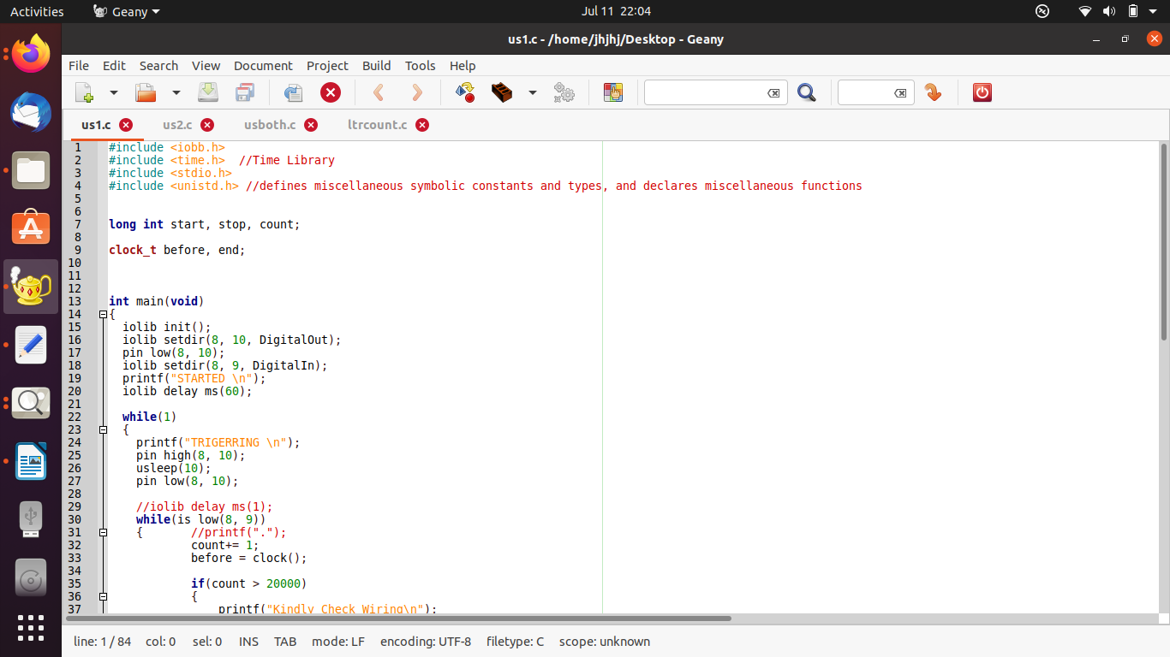
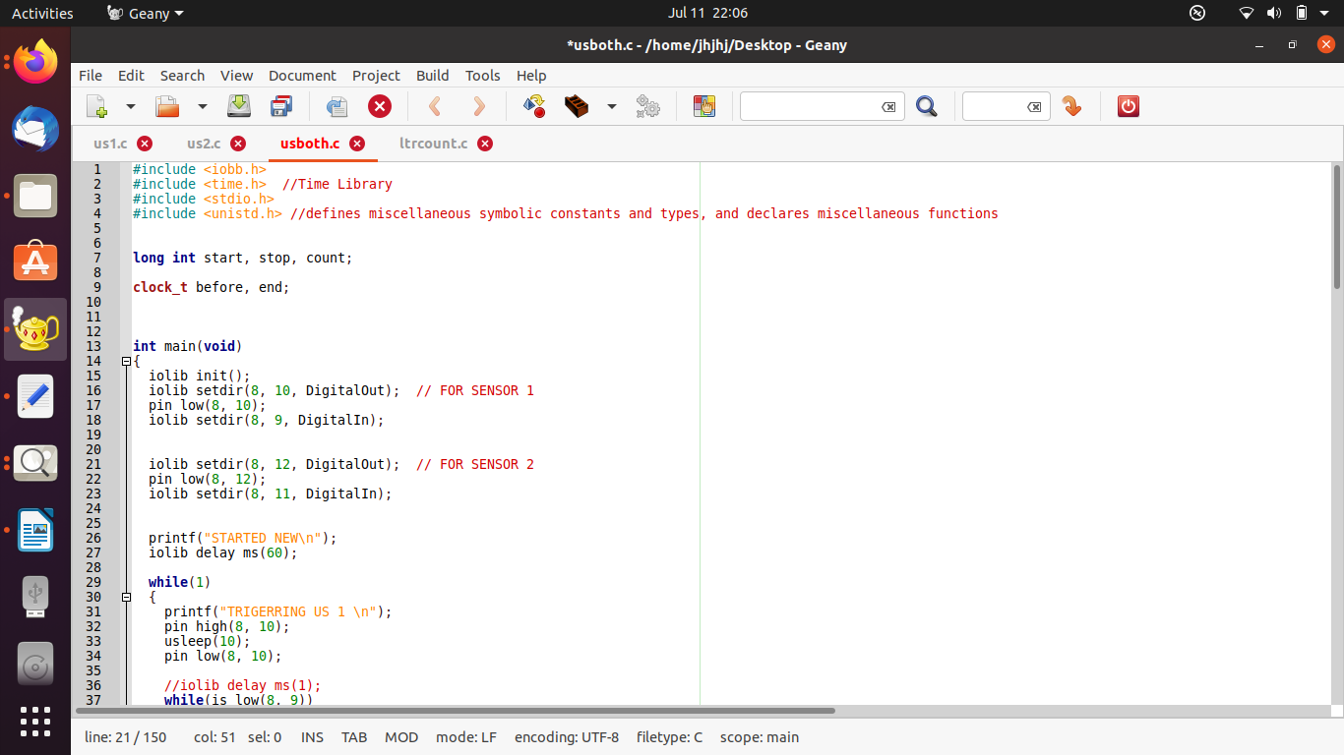
Interfacing Ultrasonic sensors with Beagle Bone Black

Slide 7
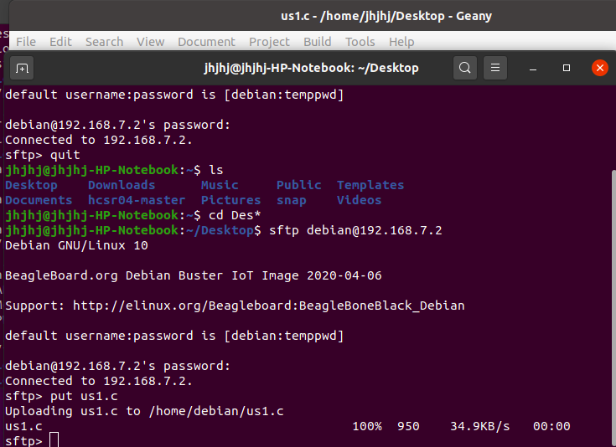
Sftp command to put files from ubuntu desktop to beaglebone debian
Moving command for c file

Slide 8
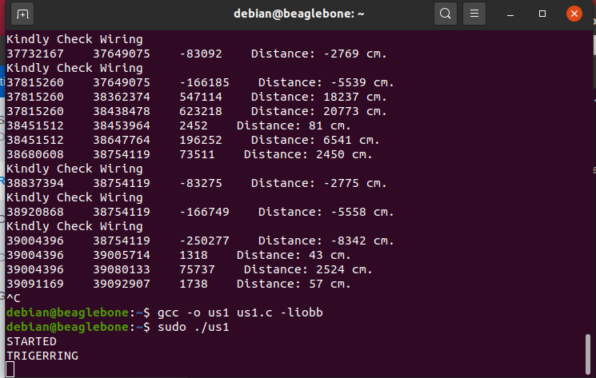
Compiling the code

Slide 9
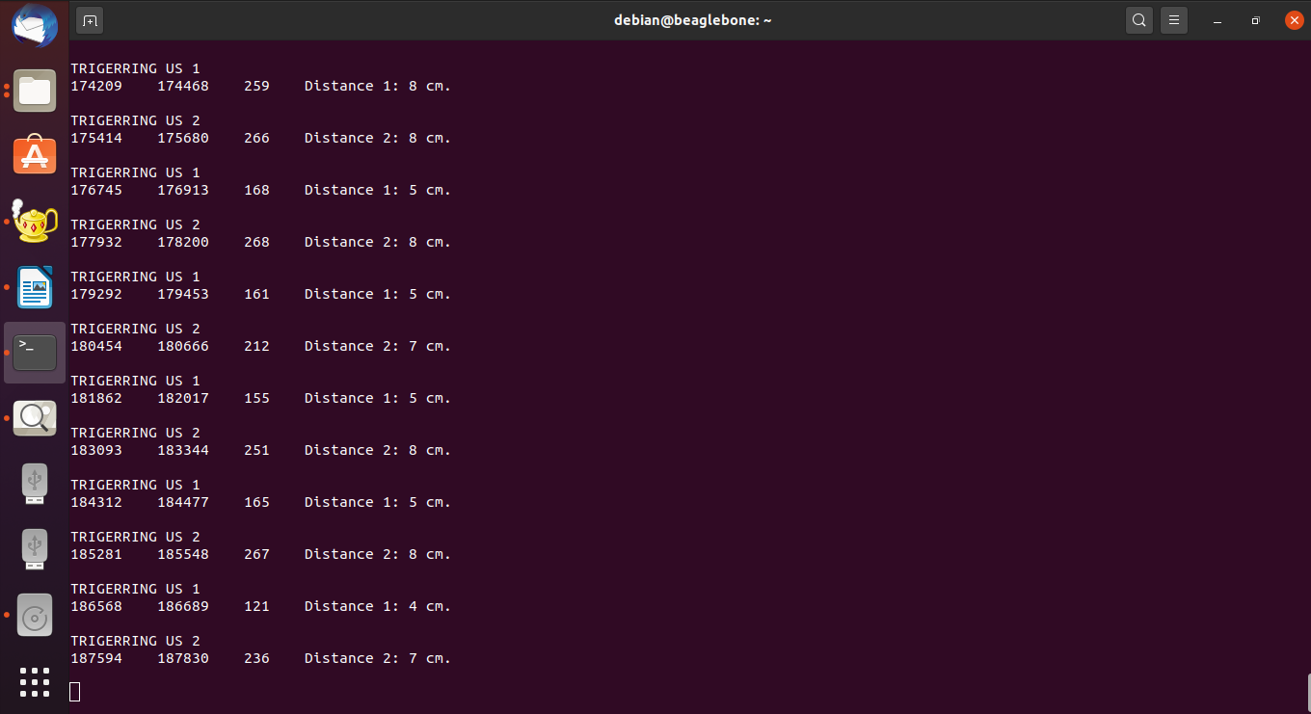
Working of two Sensors.

Slide 10
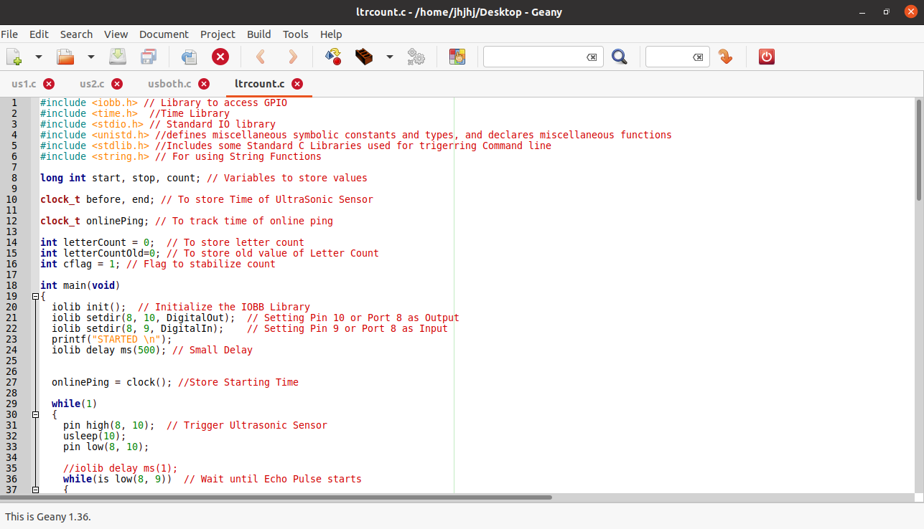
Letter Counting using C code

Slide 11
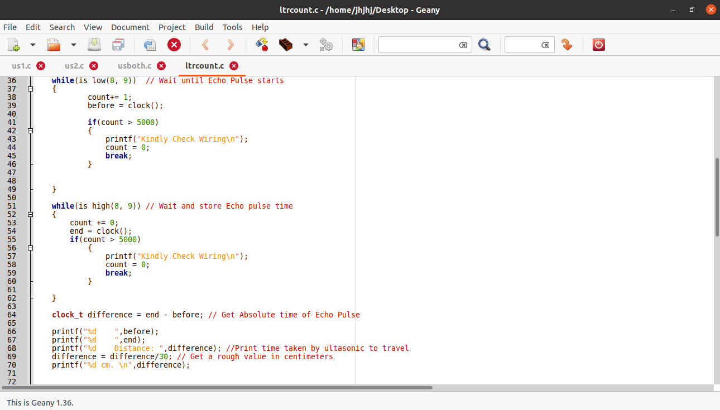

Slide 12
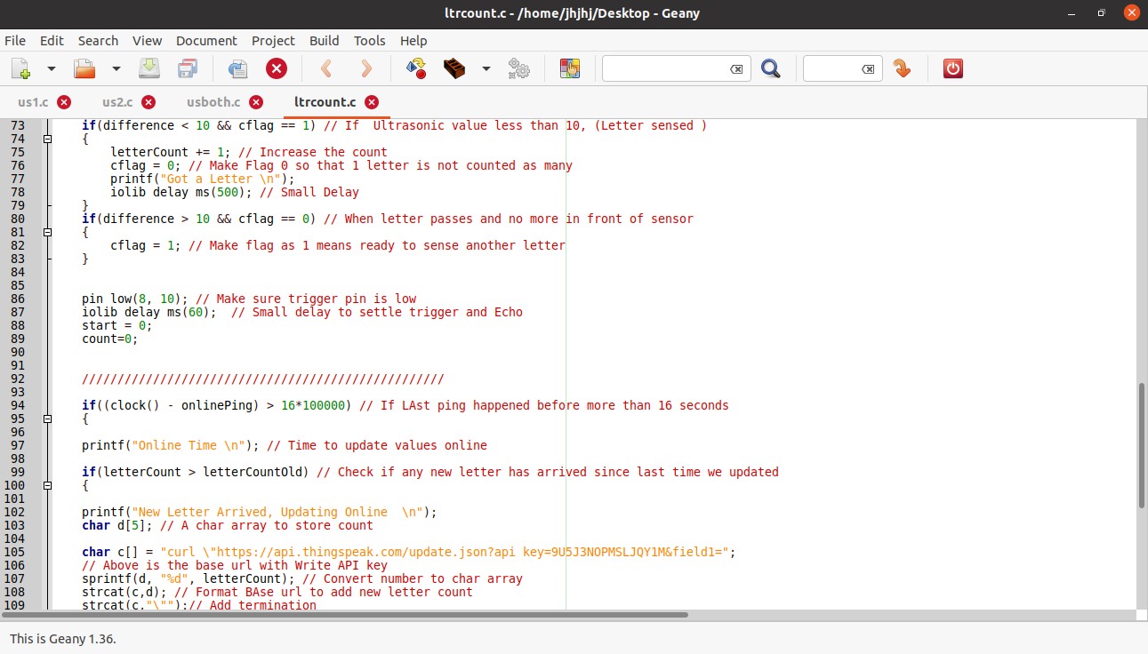

Slide 13
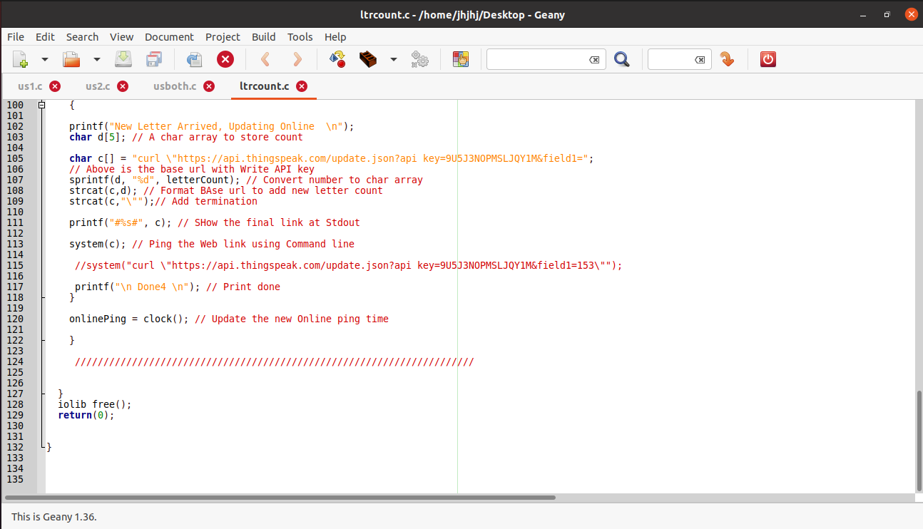

Slide 14
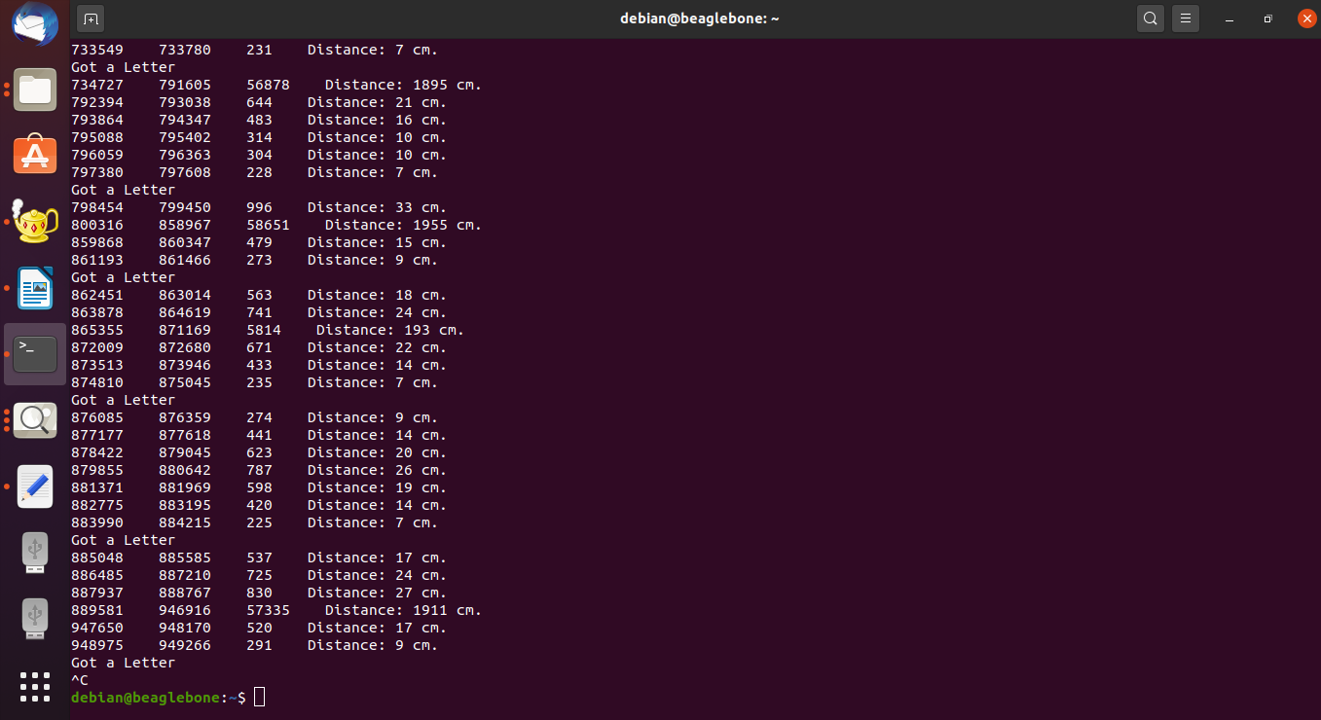
OUTPUT OF LETTER COUNTING CODE

Slide 15
Setting up ThingSpeak Service
Create an account on Thing Speak website for further access.
Create a channel with required fields we need in our project.
Each channel has unique Api key for downloading and uploading the data.
writeKey is used to write some data on channel and read api key allow others to read and getting information.

Slide 16
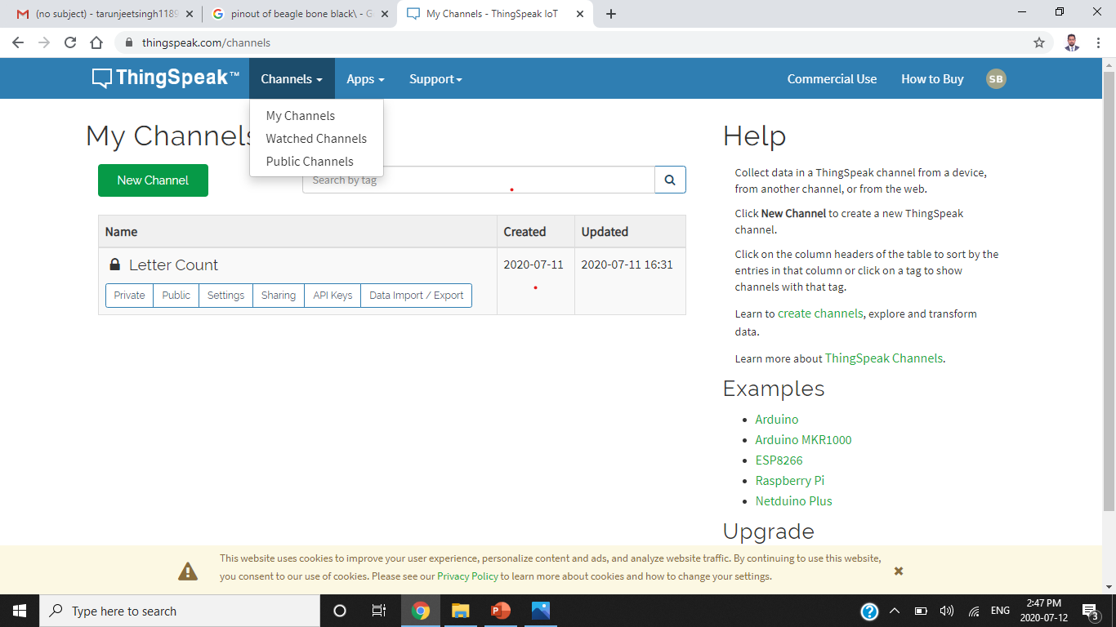
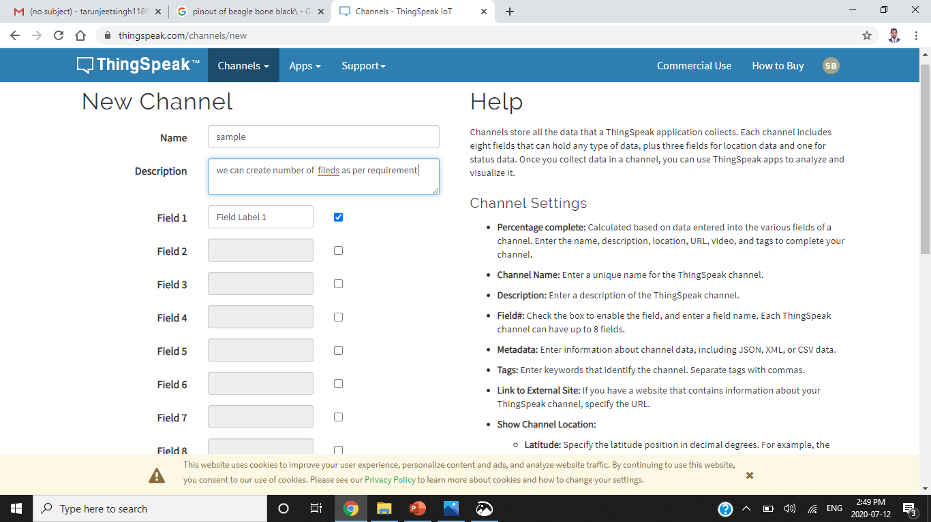
Creating Channel

Slide 17
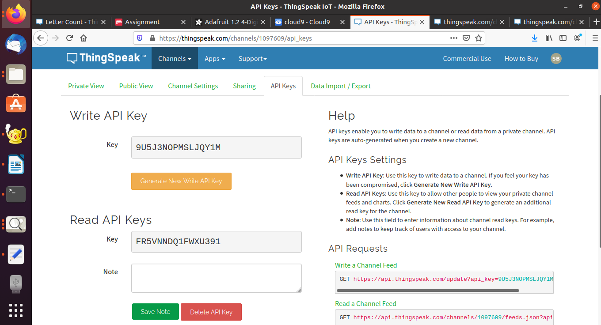
API Keys in channel

Slide 18
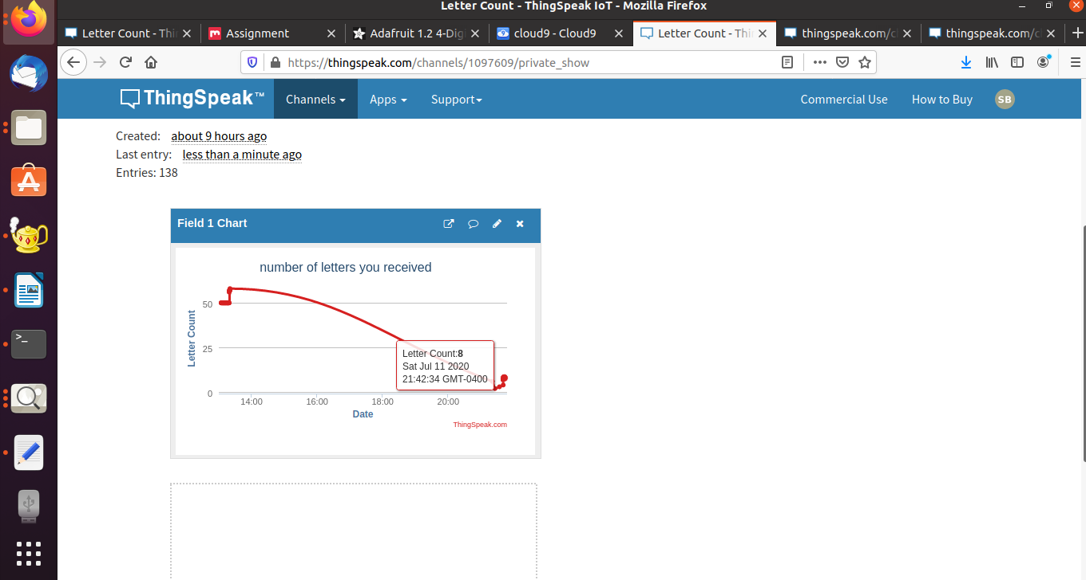
Output at ThingSpeak

Slide 19
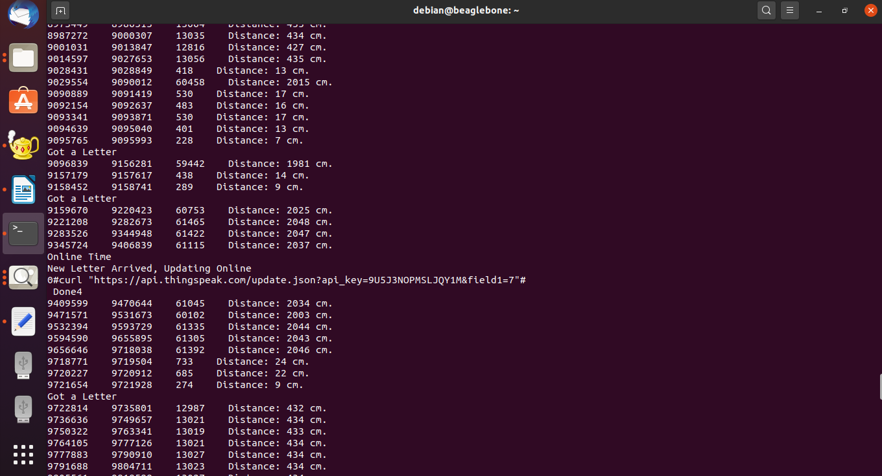
It updates the data after every 15 seconds

Slide 20
REFERENCES
Beagle Bone Pinout. (n.d.). Retrieved from Components101.com: https://components101.com/microcontrollers/beaglebone-black-pinout-datasheet
Stack overflow. (n.d.). Retrieved from Reading multiple ultrasonic sensors with BBB using python: https://stackoverflow.com/questions/45901935/reading-multiple-ultrasonic-sensors-with-bbb-using-python
ThingSpeak Community. (n.d.). Retrieved from Send Data to ThingSpeak with Arduino: https://community.thingspeak.com/tutorials/arduino/send-data-to-thingspeak-with-arduino/
Upgrade the software on your Beagle. (n.d.). Retrieved from beagleboard.org: Upgrade the software on your Beagle
https://beagleboard.org/upgrade

